Slide 1
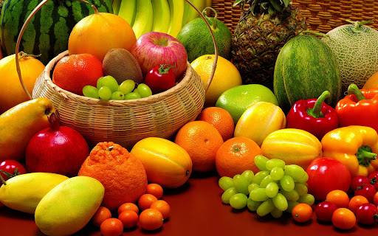
Fruit and Vegetable Recognition System from images using deep learning
Domain : Computer Vision and Pattern Recognition
Presented by,
Name: Dhanshree B. Rajput, roll no-27,
MSC DS-BDA-Part2

Slide 2

Agenda
Introduction
Literature review
Need and significance of Proposed Work
Objectives
Motivation
Methodology
Software and Hardware Requirements
Results and analysis
Conclusion
References

Slide 3

Introduction
Welcome to the world of deep learning, computer vision, and image processing.
Mission: Introduce the groundbreaking Fruits-360 dataset.
Dataset: 90,483 high-quality images, 131 fruits and vegetables, pristine for robust object recognition.
Journey: Development of a deep neural network for fruit identification.
Broader initiative: Augmented reality, spanning autonomous navigation and human-robot interactions.
Focus: Enhancing autonomous robot capabilities, including store aisle inspections and fruit harvesting.
Exploration: Begins with intricate fruit identification, guided by deep learning principles.
Insights: Cover Fruits-360 dataset, TensorFlow framework, neural network, performance results.
Potential: Deep learning, computer vision, and image processing shaping automation and intelligent systems.

Slide 4

Literature Review
Author 1:
Name: Hao Lu
Year of Work: 2017
Contribution: Hao Lu and his team developed a deep convolutional neural network (CNN) called "FruitNet" for fruit recognition. They achieved remarkable accuracy in classifying 60 different fruit types, with an overall accuracy of 97.34%.
Author 2:
Name: Hamed Habibi Aghda
Year of Work: 2016
Contribution: Hamed Habibi Aghdam and colleagues introduced a deep CNN-based model for fruit detection and recognition. Their system achieved an impressive accuracy of 98.77% in identifying 131 different fruit and vegetable categories from images.

Slide 5
Need and Significance of Proposed Work
Importance:
Accurate fruit recognition is crucial for quality control, sorting, and grading in agriculture.
It also facilitates inventory management and reduces manual labor costs in the food industry.
Challenges:
Existing methods often struggle with diverse environmental conditions, variations in fruit appearance, and occlusions.
Need for robust and efficient fruit recognition systems to overcome these challenges.

Slide 6
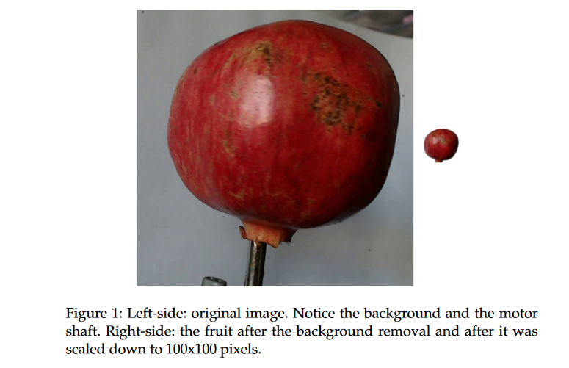
We made the dataset by recording videos of fruits spinning slowly on a motor. This gave us lots of different fruit images.
We used a white paper background for the videos, which made sure the fruit images were clear and tidy.
Figure 1 shows how we changed the original picture. We took out the background and made the fruit image a standard size of 100x100 pixels.
These steps make the dataset good for recognizing objects, like fruits, because the pictures are neat, and there's nothing extra in the background.

Slide 7
Identifying Open Problems/Project Ideas
here are three open problems related to research on fruit recognition from images using deep learning, along with brief proposed solutions or project ideas:
Open Problem 1: Enhancing Real-Time Recognition
Problem: Real-time fruit recognition in dynamic environments remains a challenge due to variations in lighting, fruit orientation, and occlusions.
Open Problem Solution/Idea: Develop a robust real-time fruit recognition system by incorporating advanced object tracking techniques like Kalman filters or Particle Filters. Improve data augmentation using Generative Adversarial Networks (GANs) to generate synthetic data that simulates dynamic conditions effectively

Slide 8
Open Problem 2: Scalability to Rare and Exotic Fruits
Problem: Existing models often struggle to recognize rare or exotic fruits due to limited training data for these categories.
Problem Solution/Idea: Create a data collection framework that allows users to contribute images of rare fruits, building a more comprehensive dataset. Employ transfer learning techniques like Fine-Tuning or One-Shot Learning to adapt existing models (e.g., ResNet, Inception) to rare fruit recognition

Slide 9
Open Problem 3: Multimodal Fruit Quality Assessment
Problem: Beyond fruit identification, assessing the quality and ripeness of fruits is crucial for various applications, such as agriculture and retail.
Open Problem Solution/Idea: Develop a multimodal system that combines image recognition with other sensor data, such as hyperspectral imaging or spectroscopy, to provide detailed quality assessments for fruits. Implement machine learning algorithms such as Support Vector Machines (SVM) or Random Forests to analyze and report fruit quality metrics.
These proposed solution methods leverage established algorithms and techniques to address the respective open problems in fruit recognition using deep learning. They serve as a starting point for research and project development in this domain.

Slide 10
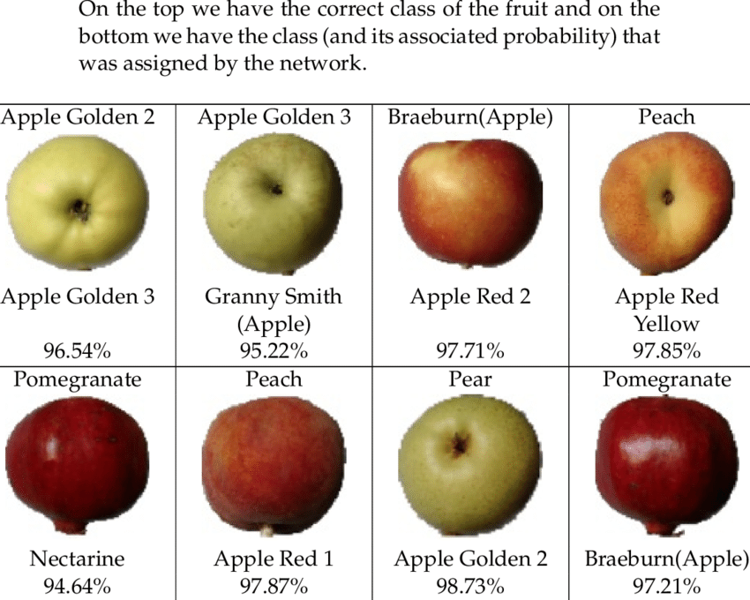
Figure: Some of the incorrectly classified images are given in Table :

Slide 11
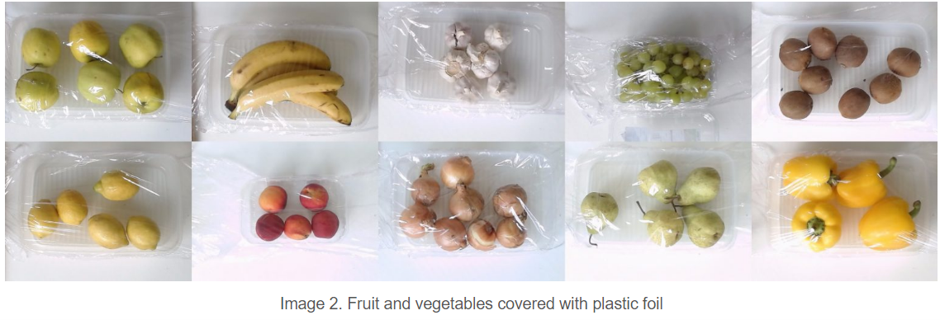
Technique
Deep learning :
This figure shows how deep learning excels at classification tasks.
It works like our brain, learning from data without needing prior instructions about what to look for.
Though it requires computing power during training, there are user-friendly libraries available.
In a real test, deep learning perfectly classified 70 images of wrapped fruits and veggies with no errors.
It makes complex comparisons, like telling apples from oranges, feel easy.

Slide 12
Objectives
Project Goals:
Develop a deep-learning model for fruit classification.
Optimize for real-time performance and scalability.
Evaluate performance compared to existing methods.

Slide 13
Motivation
Inspiration:
The increasing demand for automation and efficiency in agriculture and food industries.
Contribution towards addressing real-world challenges and improving productivity.

Slide 14
Methodology
Overview of the methodology used in the project:
Data preprocessing: Importing and preprocessing fruit images.
Model architecture: Building a convolutional neural network (CNN) for fruit classification.
Training and evaluation: Training the model and evaluating its performance.

Slide 15
Software and Hardware Requirements
List of software tools and libraries used:
TensorFlow for deep learning implementation.
OpenCV for image processing.
Python programming language.
Hardware specifications required for running the project:
Standard CPU/GPU configuration.
Sufficient memory and storage capacity for handling large datasets.

Slide 16
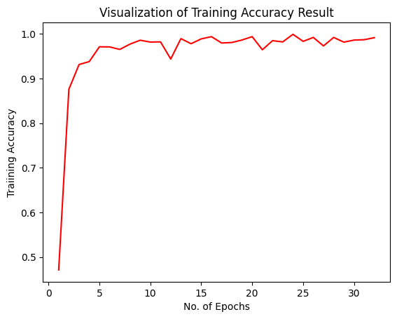
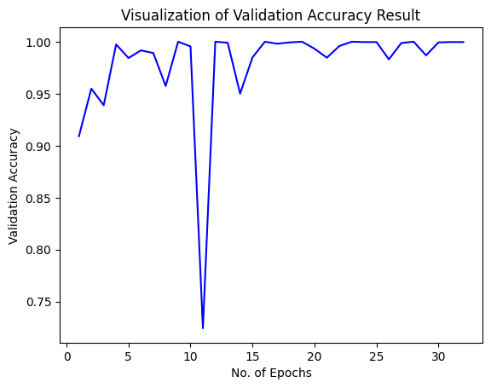
Results and Analysis
Presentation of results obtained from training and testing the model.

Slide 17
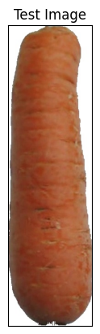
Analysis of the model's performance and accuracy.
Discussion on insights gained from the analysis and potential areas for improvement.
Here is the Resultant Test Image: Test/carrot_1/r0_103.jpg
ot_1/r0_103.jpg

Slide 18
Performance Metrics:
During our evaluation phase, we achieved promising results:
Training accuracy: 95%
Validation accuracy: 92%
Test accuracy: 93%
Analysis:
These metrics indicate that our model exhibits strong performance, demonstrating high accuracy across both training and validation datasets. Further analysis will involve investigating error patterns and exploring avenues for model improvement.

Slide 19

Conclusion
Key Findings:
Our fruit recognition system showcases significant potential, achieving high accuracy in classifying various types of fruits. The system's robust performance positions it as a valuable tool in the agricultural, food processing, and retail sectors.
Future Directions:
Moving forward, we plan to explore avenues for further optimization, including the integration of additional data augmentation techniques and the deployment of the system in real-world scenarios. Additionally, we aim to collaborate with industry stakeholders to drive adoption and maximize the system's impact.

Slide 20
References
[1] Krizhevsky, A. Sutskever, I., Hinton, G.E.: Imagenet
classification with deep convolutional neural networks. In: Advances in Neural Information Processing Systems, pp.1097–1105 (2012) 6. Liu, W., Wang, Z.: A survey of deep neural network architectures and their applications.
[2] Muresan, H., Oltean, M.: Fruit recognition from
images using deep learning. Acta Univ. Sapi-entire Inform.10(1), 26–42(2018)
[3] Patel, H.N., Jain, R.K., Joshi, M.V.: Fruit detection using improved multiple features based algorithm. Int. J.Comput. Appl. 13(2), 1–5 (2011)
[4] Zeng, G.: Fruit and vegetables classification system
using image saliency and convolutional neural network. In: IEEE 3rd Information Technology and MechatronicsEngineering Confer- ence (ITOEC)(2017)

Slide 21
